Slide 1

CANARX
Brand name medications
at no cost to employees/dependents
2024

Slide 2


Who is CANARX ?
Mail Order Prescription Service Provider
Voluntary No Cost prescription by mail program
An ADDITIONAL benefit (does not replace other pharmacy benefits)
Both Employees & Dependents are eligible
Brand-name maintenance & specialty medications
No cost to members
No copay (90-day mail order)
No deductible
No initial fees
Participating members save thousands per year
CANARX partners with licensed and regulated pharmacies in United Kingdom, Australia and Canada (Tier 1 as defined by Congress)
Simple. Safe. Smart.

Slide 3
Two popular questions
Is it legal?
All US Residents have been granted legal ability to import medications. Up to a 90-day supply, for personal use only.
These laws are detailed in the US Food, Drug & Cosmetic Act. Which is managed by Congress & the FDA.
The CANARX Service has been designed to abide by all laws and regulations therein.
How can medications be at no cost to members?
CANARX partners with pharmacies in 3 countries. These countries negotiate pricing with pharmaceutical companies. (There is no price negotiating in the U.S.) Since the CANARX program facilitates the medications sent directly from these partner pharmacies, the medication cost is the same as in that country. Average savings is 65-75%.
Since the plan is achieving substantial savings, there is no cost share to the employee (no copays)

Slide 4
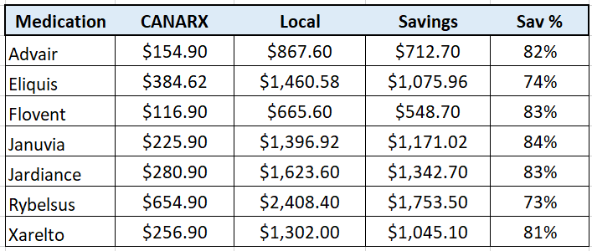
Savings Examples…
CANARX is NOT too good to be true and there is NO catch.
CANARX sources the same brand name & specialty medications, via U.S. government approved channels, for a fraction of local costs.
Cost Savings Examples: CANARX vs. local (90-day)
Simple. Safe. Smart.

Slide 5
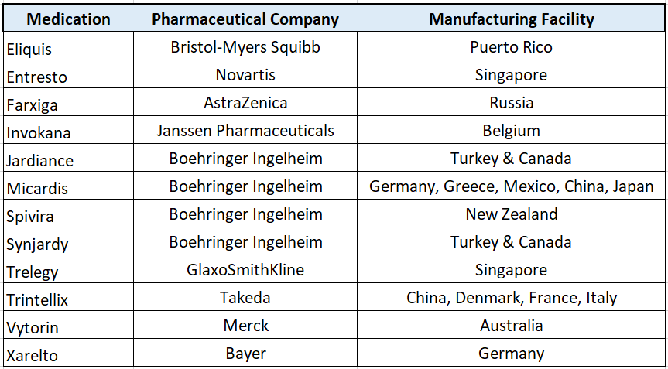
Most Medications are Manufactured Internationally
Popular Medications are manufactured all over the world…

Slide 6
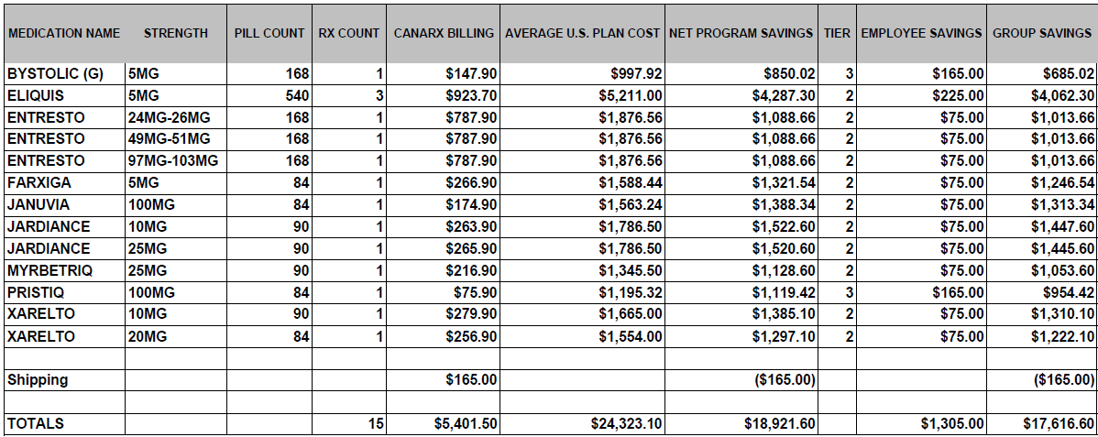
The CANARX Path to Savings
You can make a difference…
Example: Almost $228,000 annual Savings ($350 Average Co-Pay Savings)

Slide 7
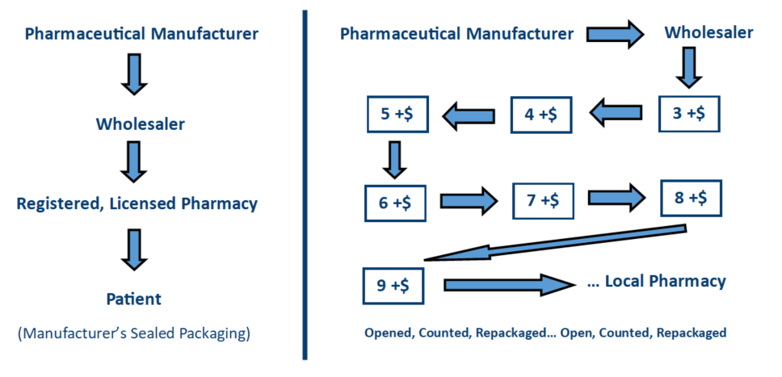
The CANARX Path to Savings
How does CANARX do it?
CANARX
Your Local Pharmacy

Slide 8

Is it safe?
CANARX set the Safety Standard
All pharmacies are licensed and regulated in Tier-1 Countries
U.S. physician’s license verified for every order
Drug utilization review completed on every order
Original manufacturer sealed packaging
Medication info documents included with every order
Every prescription is insured
On-going, proactive patient communication
24/7 emergency support line
CANARX is the safe choice.
Notes:
At Canarx, Safety is our #1 priority.
In fact, we set the safety standard in the industry.
All of our pharmacies are licensed and regulated in Tier-1 Countries. Which means, that US Congress has recognized them as being able to deliver health goods and services as well or BETTER than here in the United States.
All physician licenses are verified with each prescription.
A drug utilization review is completed with EACH order to ensure that no negative interactions will occur.
And every order is delivered in its Original Manufacturer’s SEALED container. Along with a patient medication information leaflet.
Finally, and what is perhaps the BEST part of the canarx program, is the continuous communication you will have with our customer support team. They will reach out to you every 90 days to make sure that we are exceeding your expectations
And, of course, a 24/7 phone line is available to you for any urgent support matter you may need. You can see why Canarx is the safe choice.

Slide 9
What medications are available?
Brand name maintenance & specialty medications ONLY
Controlled formulary:
No generics
No temperature sensitive medications
No controlled substances
No precursors
No Risk Evaluation and Mitigation Strategy (REMS) medications
No medication substitutions
CANARX is the safe choice.
Notes:
At Canarx, Safety is our #1 priority.
In fact, we set the safety standard in the industry.
All of our pharmacies are licensed and regulated in Tier-1 Countries. Which means, that US Congress has recognized them as being able to deliver health goods and services as well or BETTER than here in the United States.
All physician licenses are verified with each prescription.
A drug utilization review is completed with EACH order to ensure that no negative interactions will occur.
And every order is delivered in its Original Manufacturer’s SEALED container. Along with a patient medication information leaflet.
Finally, and what is perhaps the BEST part of the canarx program, is the continuous communication you will have with our customer support team. They will reach out to you every 90 days to make sure that we are exceeding your expectations
And, of course, a 24/7 phone line is available to you for any urgent support matter you may need. You can see why Canarx is the safe choice.

Slide 10
Member Benefits – Why Join?
No cost brand name maintenance & specialty medications
Shipped direct to member’s door (no shipping charges)
Worry-free refills
Join anytime during the benefit year
Quick and easy enrollment process
Online Enrollment (enroll from any device)
CANARX is the safe choice.
Notes:
At Canarx, Safety is our #1 priority.
In fact, we set the safety standard in the industry.
All of our pharmacies are licensed and regulated in Tier-1 Countries. Which means, that US Congress has recognized them as being able to deliver health goods and services as well or BETTER than here in the United States.
All physician licenses are verified with each prescription.
A drug utilization review is completed with EACH order to ensure that no negative interactions will occur.
And every order is delivered in its Original Manufacturer’s SEALED container. Along with a patient medication information leaflet.
Finally, and what is perhaps the BEST part of the canarx program, is the continuous communication you will have with our customer support team. They will reach out to you every 90 days to make sure that we are exceeding your expectations
And, of course, a 24/7 phone line is available to you for any urgent support matter you may need. You can see why Canarx is the safe choice.

Slide 11
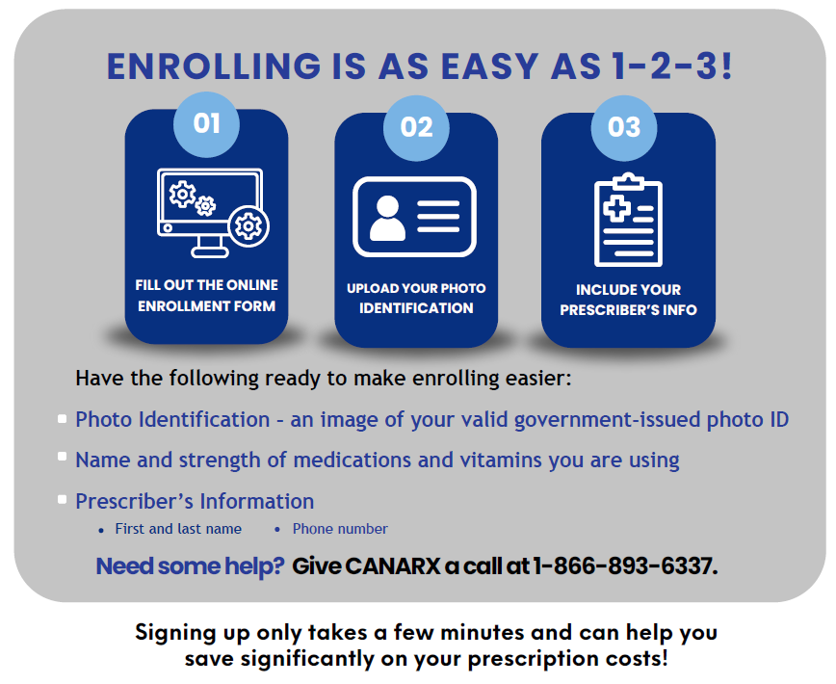
Easy Online Enrollment

Slide 12

Thank You !
JIM RILEY
jim.riley@canarxgroup.com

