Slide 1
EPA Brownfields ABCA Public Meeting
Boulter Farm Area, Parcels 29-15 & 29-16, 230 Mendon Road, North Attleboro, MA

Slide 2
Site History
1940 to 1970s: Samuel Boulter used western portion of site and 30+ acres in Cumberland RI to reportedly receive and store waste.
Courtois Sand & Gravel operated the site from 1940 to the 1980s
Town acquired the property as a tax taking in 1998
EPA performed assessment from 2002 to 2010
Contamination accumulated in lowing lying areas formed 2 lagoons (1 in RI and 1 at Parcel 29-15)
NOTE: This “site” is separate from the release of cyanide at 501 Mendon Road in Attleboro

Slide 3
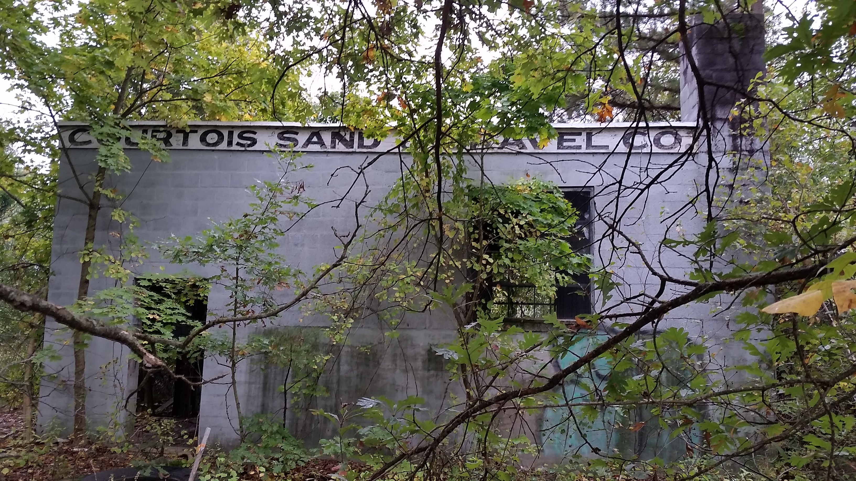
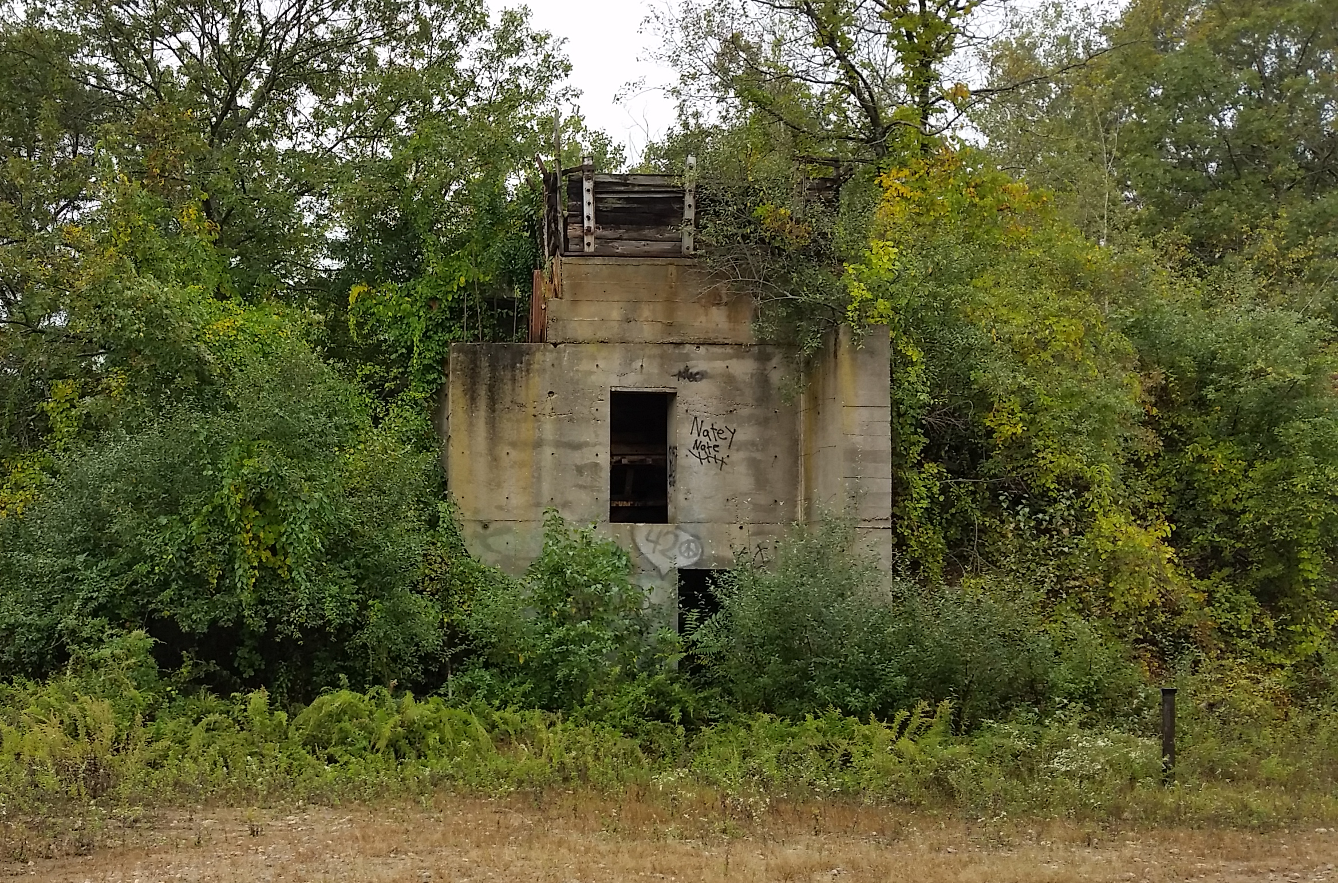
MassDevelopment Assessment Grant ($90K)-2016
EASTERN PORTION OF SITE
Review of facility site history and practices
Review of prior assessment activities
Soil and groundwater sampling program
Geophysical survey
RTN 4-26387 (2016): Petroleum release

Slide 4
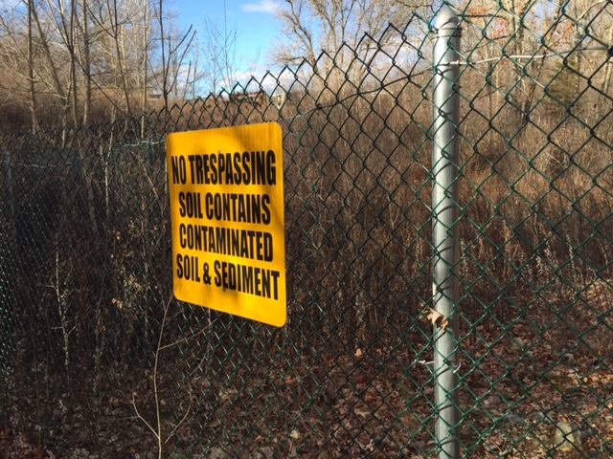
MassDevelopment Assessment Grant ($90K)-2016
WESTERN PORTION OF SITE
Review of EPA reports
Review of prior assessment activities
RTN 4-19736 (2006): Release of PCBs and petroleum
Town installs fenced enclosure (lagoon)
RTN 4-26387 (2016): Lead and zinc

Slide 5
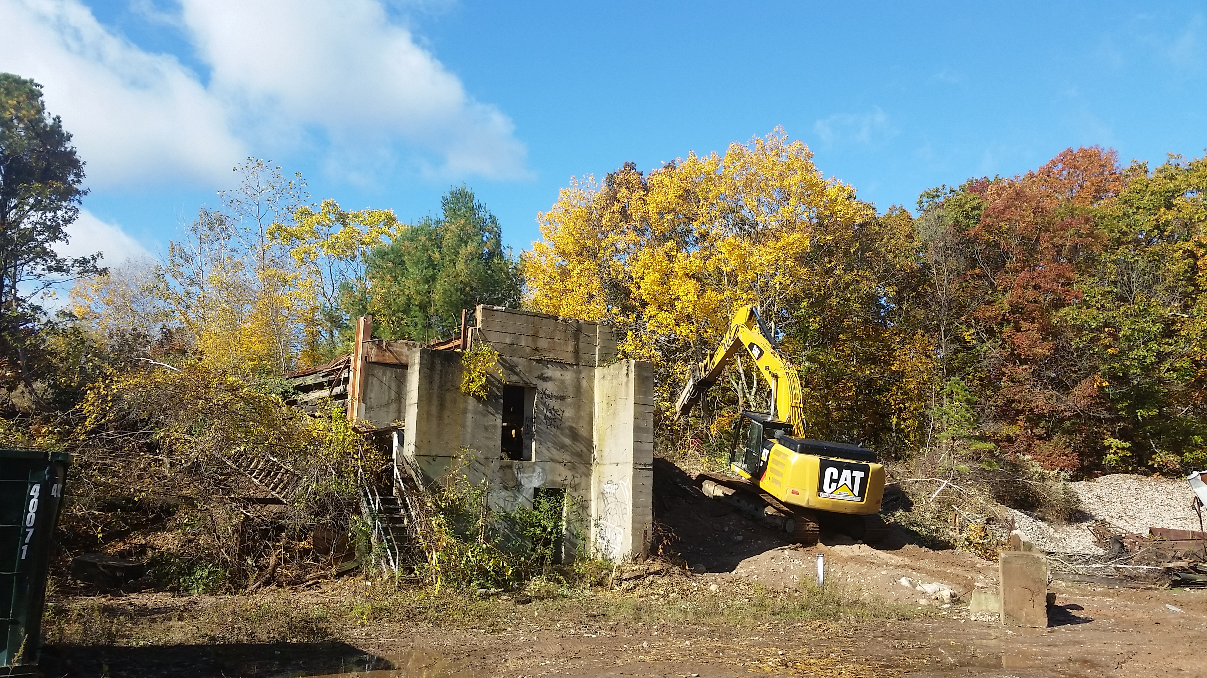
EPA Cleanup Grant ($240K)-2018
EASTERN PORTION OF SITE
Building Abatement and Demolition
Tank removal
Soil excavation and disposal (450 tons)
MCP Permanent Solution
20% Cost Share
Clean Backfill
Fencing
Site Restoration

Slide 6
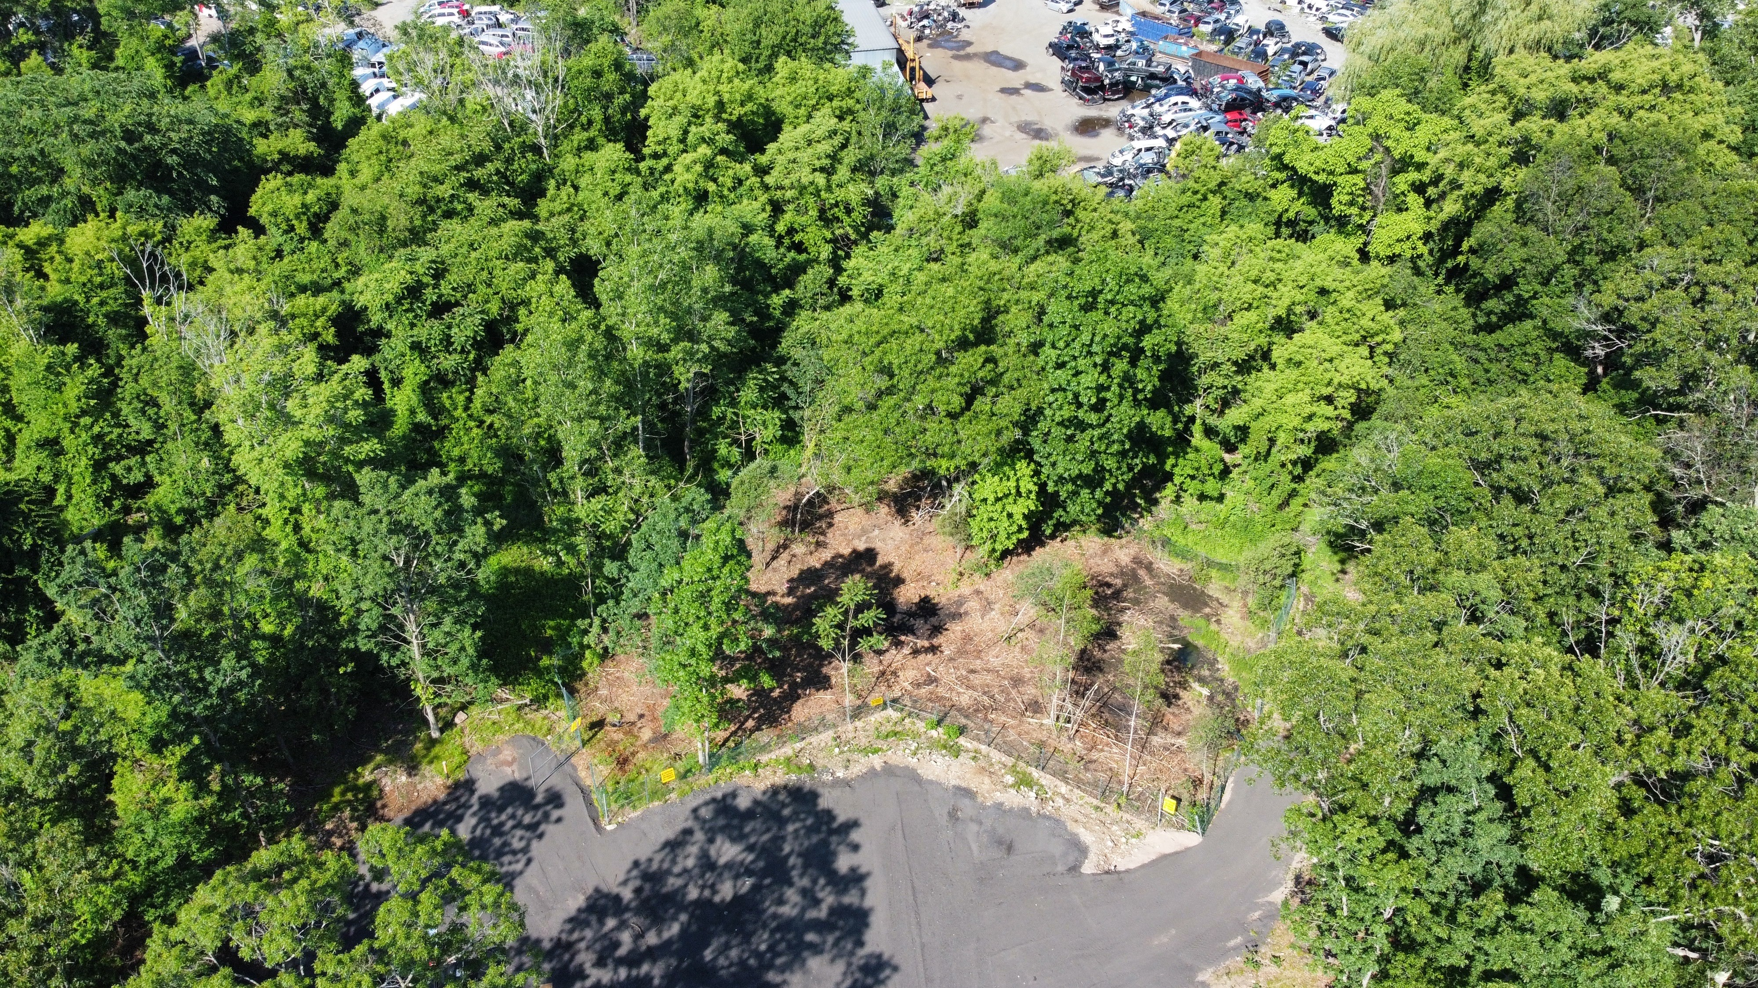
EPA Cleanup Grant ($500K)-2021-2024
WESTERN PORTION OF SITE
Vegetation Clearing
Geophysical Survey
Lagoon Soil Characterization
Baseline Groundwater Sampling
Analysis of Brownfields Cleanup Alternatives (ABCA)
Public Bid Specifications
EPA and MassDEP reports
20% Cost Share

Slide 7
ABCA Alternatives
ALTERNATIVE #1-No Action
No cleanup activities performed
Low cost
Ineffective in controlling or preventing OHM exposure
Not resilient to climate change impacts

Slide 8
ABCA Alternatives
ALTERNATIVE # 2: Ex-Situ Remediation and Post-Remedial Groundwater Monitoring
Treat TCLP Lead Soils
Apply drying agent
Excavate impacted soils (PCBs< 50 ppm and PCBs > 50 ppm)and backfill
Effective at source removal
Limited monitoring
Mitigates receptor risk
Costly-Estimated at $1.6M

Slide 9
ABCA Alternatives
ALTERNATIVE # 3: Institutional Controls, Passive Containment, Monitoring
No Soil excavation
Installation of impermeable engineered cap
Permanent fenced enclosure
Contaminant Source is not removed
Mitigates receptor risk
Ongoing groundwater monitoring and cap inspection
Activity and Use Limitation (AUL)-Administrative Control
Estimated at $453K

Slide 10
ABCA Alternatives
ALTERNATIVE # 4A: Targeted Ex-Situ Remediation and Institutional Controls, Passive
Containment, Monitoring:
Targeted soil excavation
Installation of impermeable engineered cap
Permanent fenced enclosure
Contaminant Source is not removed
Mitigates receptor risk
Ongoing groundwater monitoring and cap inspection
Activity and Use Limitation (AUL)-Administrative Control
Estimated range: $700K to $1M

Slide 11
Questions?

