Slide 1
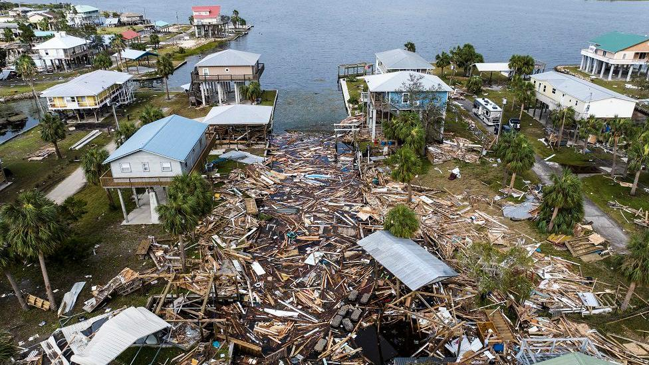
Hazard Mitigation Plan
Town of North Attleboro

Slide 2
OVERVIEW
Disaster can strike at any time
The Hazard Mitigation Plan is a guide to prepare, respond, mitigate and recover from a disaster.
The Plan is a FEMA Requirement to be eligible for funding and grant opportunities.
Must be updated every 5 years.
Departments included in the plan update include Fire, Police, Town Management, Planning, Conservation, NAED, Public Works, Health, Council on Aging, and Schools.
Two (2) Public Meetings

Slide 3
What is Hazard Mitigation
Defined by FEMA as any sustained action taken to reduce or eliminate the long-term risk to human life and property from hazards.
Our updated plan meets the requirements of the Disaster Mitigation Act of 2000 and 44 CFR&201.6(d)(3).

Slide 4
PURPOSE
Provide the Town of North Attleboro with a comprehensive examination of all natural hazards affecting the area, as well as a framework for informed decision-making regarding the selection of cost-effective mitigation actions.
When implemented, these mitigation actions will reduce the Town’s risk and vulnerability to natural hazards.

Slide 5
HAZARDS IDENTIFIED
Temperature extremes
Changes in groundwater (covered in flooding and drought sections)
Drought
Earthquakes
Flooding from dam overtopping
Flooding from precipitation
Hurricanes/Tropical Storms

Slide 6
HAZARDS CONT.
Invasive Species
Other Severe Weather
Severe Winter Storms
Tornadoes
Wildfires and Brush Fires

Slide 7
GOALS
Save Lives and Property
Assess High Hazard Potential Dams
Local Plans and Regulations
Buildings and Infrastructure
Natural Resources
Education on the Plan

Slide 8
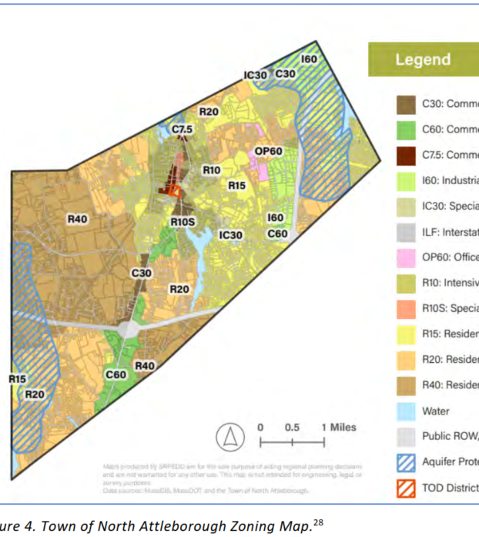
OTHER AREAS COVERED
Land use
Planning Area Profile of the Town
Identifies the four major watershed areas.
Identifies the major aquifers in town.
Town Forest and Open Space
Water and Sewer Service
Energy/Power
Critical Infrastructure

Slide 9
OTHER AREAS COVERED CONT.
Critical Transportation Routes and Services
Dams
Economy
Historical and Cultural Resources

Slide 10

FLOODING
PRECIPITATION AND DAM FAILURES

Slide 11
FLOODING FACTS
Nationally, Flooding causes more damage annually than any other event
River and Stream Flooding
Drainage Related Flooding
Secondary Hazards, including fluvial erosion, riverbank erosion, and landslides.
Flooding due to ice jams.

Slide 12
10 MILE RIVER FLOODING
Has been a major concern for over a decade.
Floods in 2010 caused flooding along the river
After the 2010 storm, the BETA Group performed a study on the flooding and river impact.
The Study prioritized mitigating flooding along the river
Recommendations from the study included a hydraulic model of the river, replacement of retaining walls, providing storm water relief, and removing the accumulation of sediments in certain areas

Slide 13
10 MILE RIVER CHALLENGES
FEMA has approved funding for previous studies; however, it will not support funding for much-needed dredging
The town has secured town funds to conduct some dredging
Ownership of the 10-mile river is shared as multiple areas are privately owned.
Multiple culverts and bridges draining to or associated with the 10-mile river require cleaning or dredging, which exacerbates flood events.
The 10 Mile River spans across many communities, including Plainville and Attleboro, and requires partnerships to provide a 100 percent fix.

Slide 14
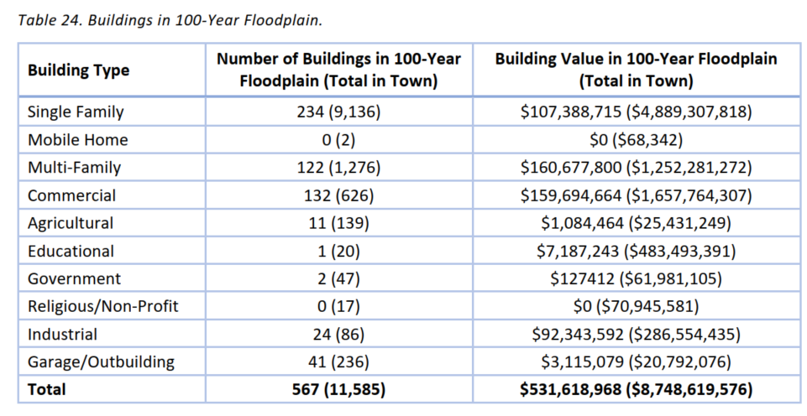
100 YEAR FLOODPLAIN

Slide 15
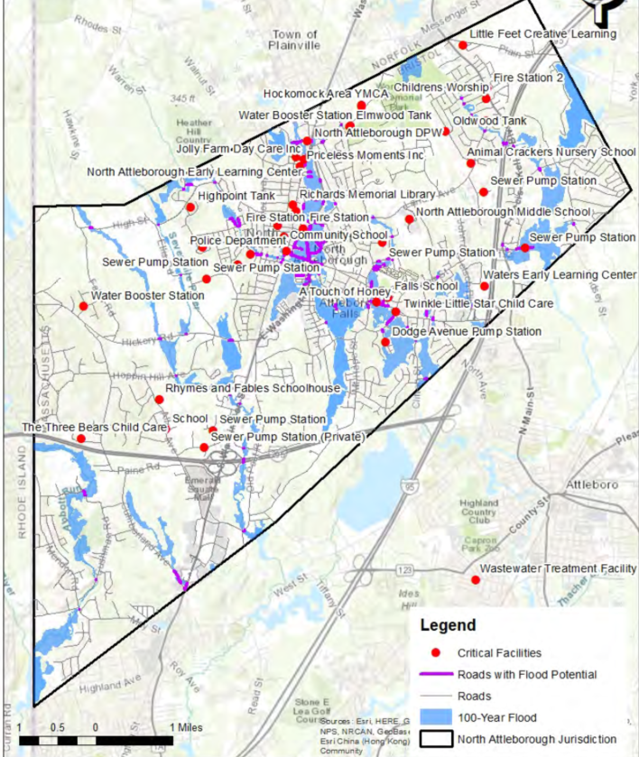
100-YEAR FLOOD PLAIN ROADS AND CRITICAL INFRASTRUCTURE IMPACT

Slide 16
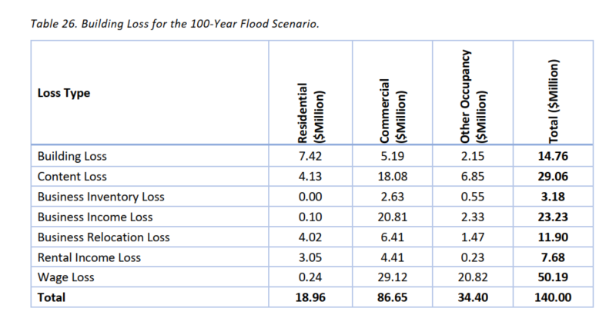
BUILDING LOSS 100 YEAR FLOOD

Slide 17
DAM FLOODING

Slide 18
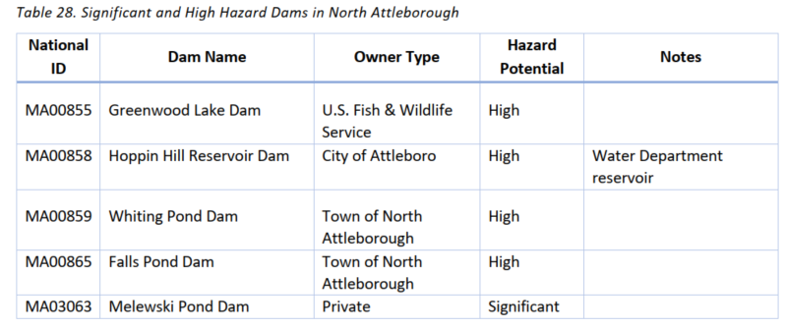
NORTH ATTLEBORO DAMS

Slide 19
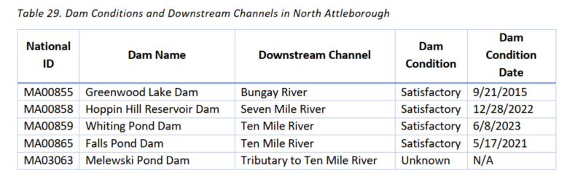
DAM CONDITIONS

Slide 20
FLOODING FROM DAMS
Dam flooding in Massachusetts is often a direct result of severe flooding but can also be the result of infrastructure failure.
Dam overtopping is the result of floods exceeding their capacity, inadequate spillway design, blockage of spillways, and other causes.

Slide 21
CEMP PLAN (Comprehensive Emergency Plan)

Slide 22
CEMP PURPOSE
To guide response activities and ensure effective and efficient coordination
Outlines relationships between local, state, regional, and federal partners
Formulates policies designated to protect life and property during incidents
Guides strategic thinking and decision making
Provides checklists and specific job descriptions for key stakeholders.
Identifies lines of authority
Establishes NIMS (National Incident Management System and ICS as the organization structure.

Slide 23
SECTIONS
Concept of Operations
Direction, Control, and Coordination
EOC Staffing and Procedures
Organizational Structure and Responsibilities
Information Collection and Dissemination
Communications
Admin, Finance, Logistics
Training
SOP Development

Slide 24
HIRA(Hazard Identification and Risk Assessment)

Slide 25
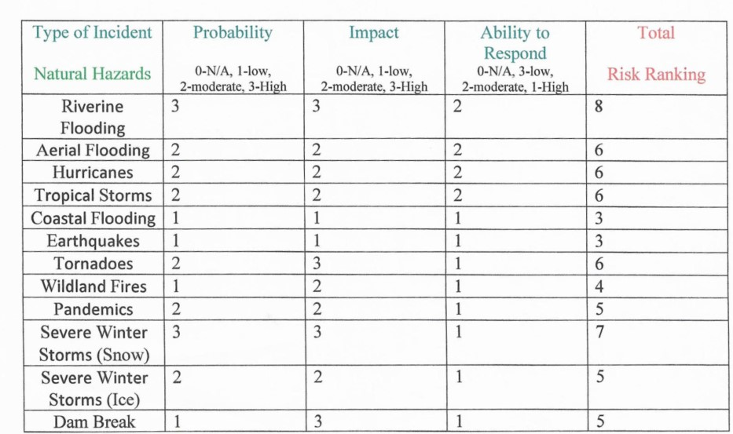
NATURAL HAZARDS

Slide 26
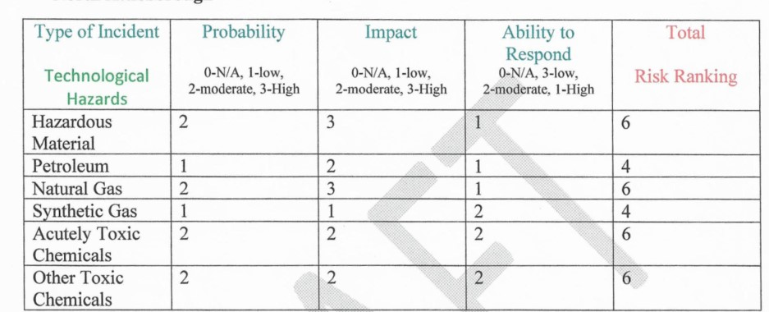
TECHNOLOGICAL HAZARDS

Slide 27
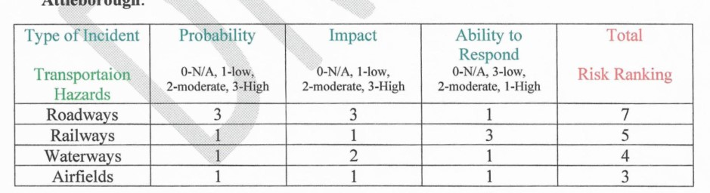
TRANSPORTATION

Slide 28
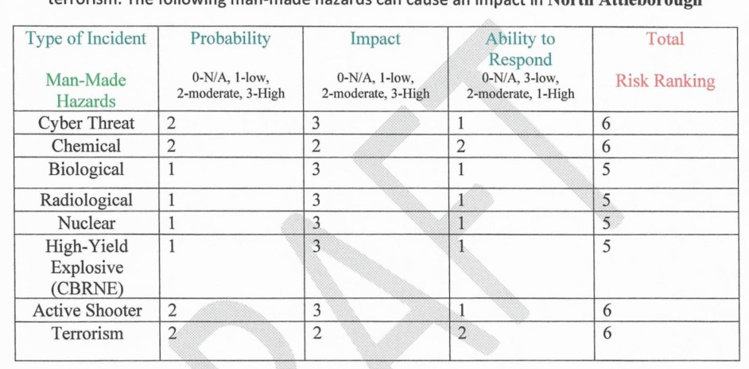
MANMADE

Slide 29
SUMMARY
Flooding and Dam Failure are both high concerns for impact on our community
National Climate Assessment predicts more precipitation
The Resilient Mass Plan estimates precipitation will increase 6-14% by mid-century
Increase in flood frequency meeting current 10-year flood levels
Continue to monitor our waterways and pursue all funding opportunities to attempt at mitigating flood risk.
Continuously update our Hazard Mitigation, CEMP, and Dam Plans.

